Slide 1
12 14 factor app
15/04/2022

Slide 2
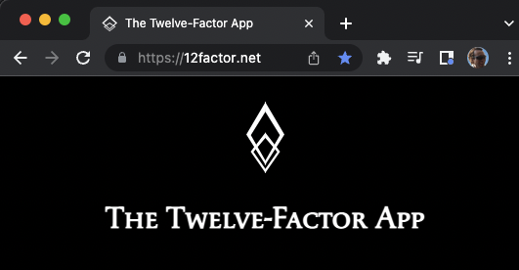
The twelve-factor app

Slide 3
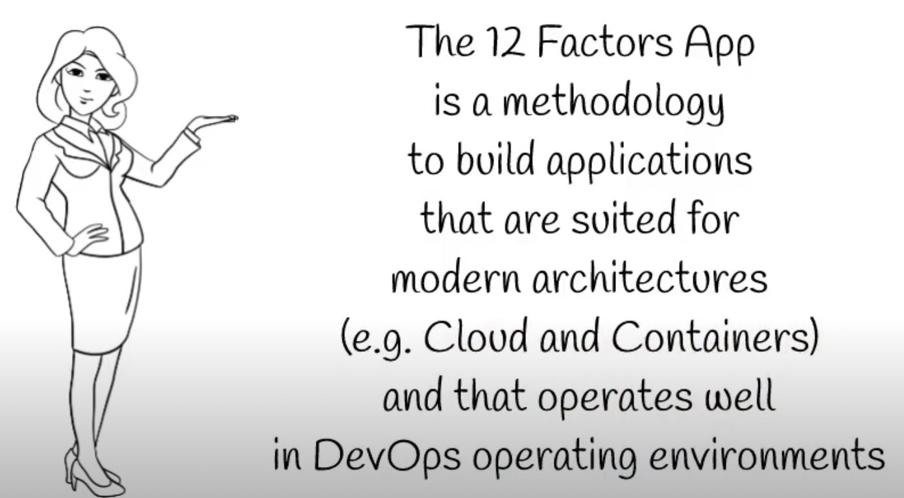
what

Slide 4
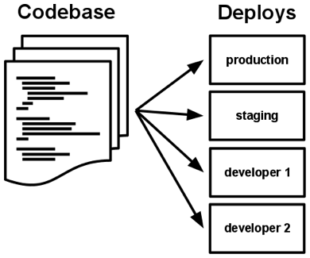
I. Codebase
One codebase tracked in revision control, many deploys
A codebase is any single repo or any set of repos who share a root commit

Slide 5




II. Dependencies
Explicitly declare and isolate dependencies
A twelve-factor app never relies on implicit existence of system-wide packages

Slide 6
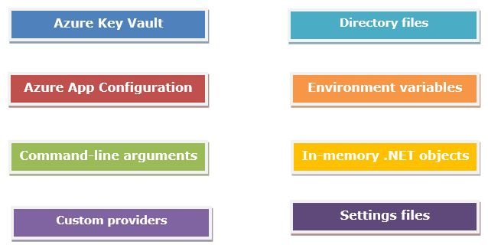
III. Config
Store config in the environment
strict separation of config from code

Slide 7
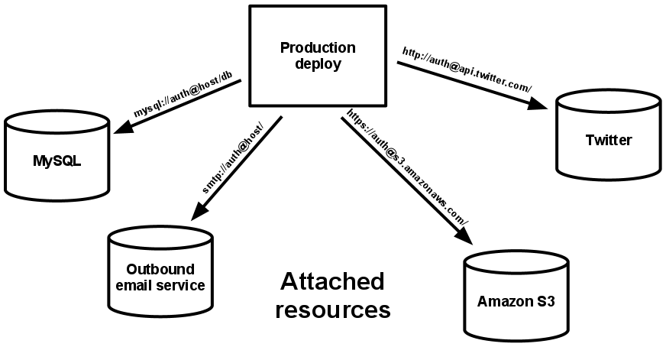
IV. Backing services
Treat backing services as attached resources
The code for a twelve-factor app makes no distinction between local and third party services

Slide 8
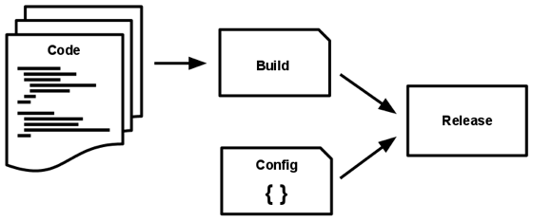
V. Build, release, run
Strictly separate build and run stages
The twelve-factor app uses strict separation between the build, release, and run stages

Slide 9
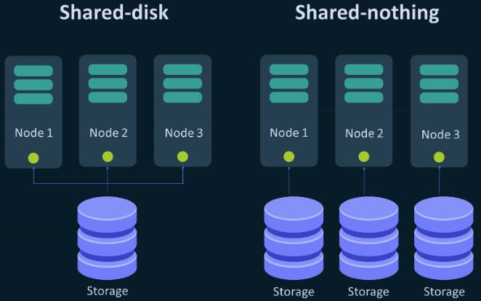
VI. Processes
Execute the app as one or more stateless processes
Twelve-factor processes are stateless and share-nothing

Slide 10
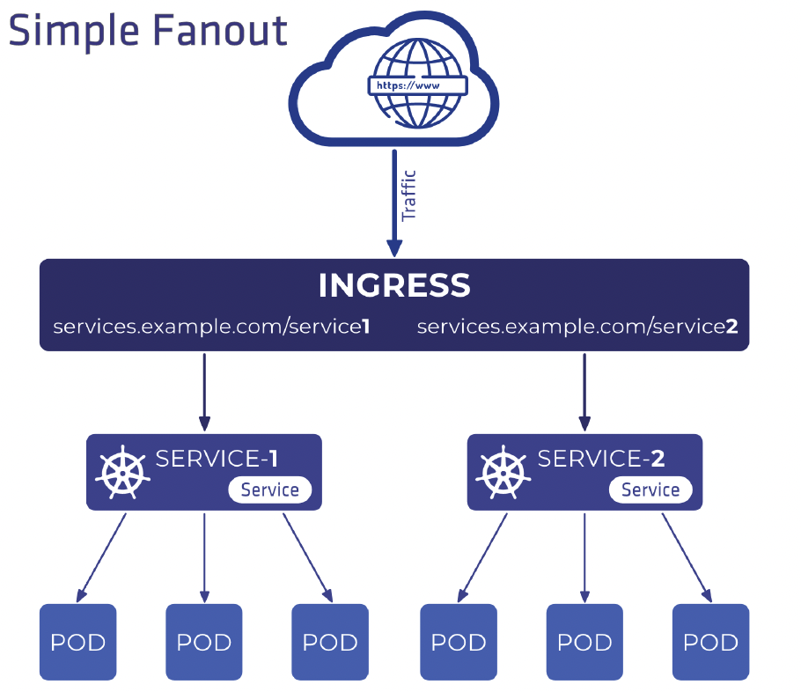
VII. Port binding
Export services via port binding
The twelve-factor app is completely self-contained

Slide 11
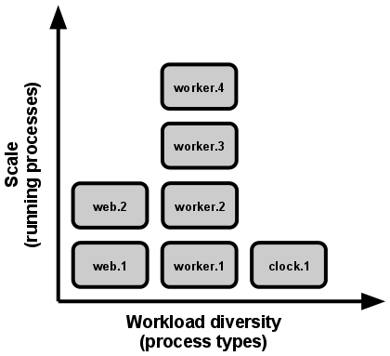
VIII. Concurrency
Scale out via the process model
In the twelve-factor app, processes are a first class citizen: the unix process model for running service daemons.

Slide 12
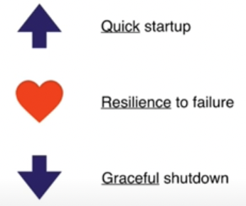
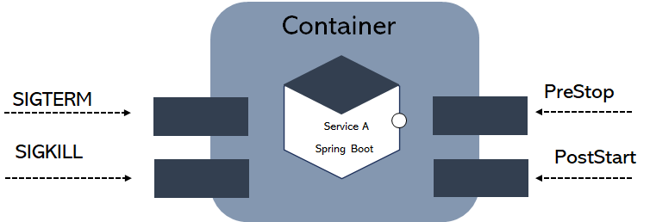
IX. Disposability
Maximize robustness with fast startup and graceful shutdown
The twelve-factor app’s processes are disposable, meaning they can be started or stopped at a moment’s notice

Slide 13
X. Dev/prod parity
Keep development, staging, and production as similar as possible
 | Traditional app | Twelve-factor app
Time between deploys | Weeks | Hours
Code authors vs code deployers | Different people | Same people
Dev vs production environments | Divergent | As similar as possible
The twelve-factor developer resists the urge to use different backing services between development and production,

Slide 14
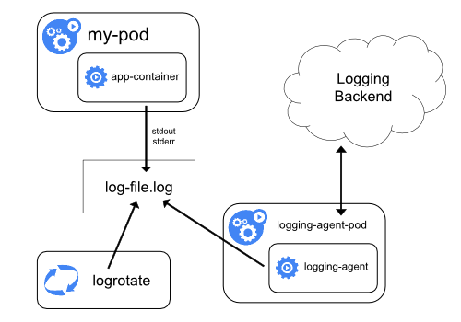
XI. Logs
Treat logs as event streams
https://kubernetes.io/docs/concepts/cluster-administration/logging/
A twelve-factor app never concerns itself with routing or storage of its output stream

Slide 15
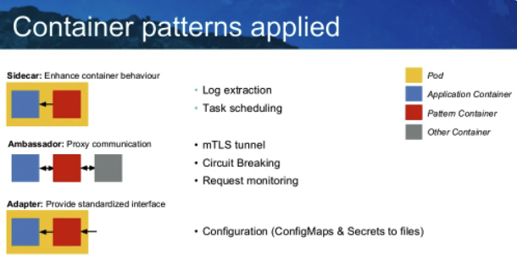
XII. Admin processes
Run admin/management tasks as one-off processes
Running database migrations, console, one-time scripts

Slide 16
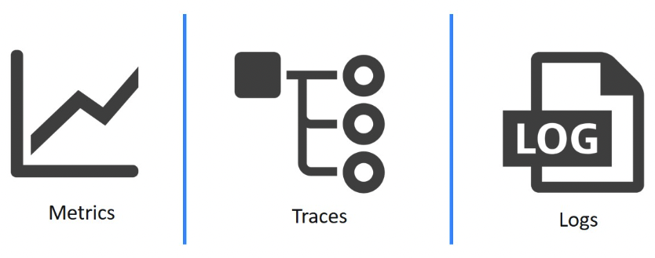
XII. Observability
Internal states of a system can be inferred from knowledge of its external outputs

Slide 17

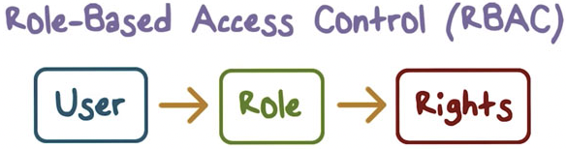

XIV. security
Modern apps should take security-first

Slide 18
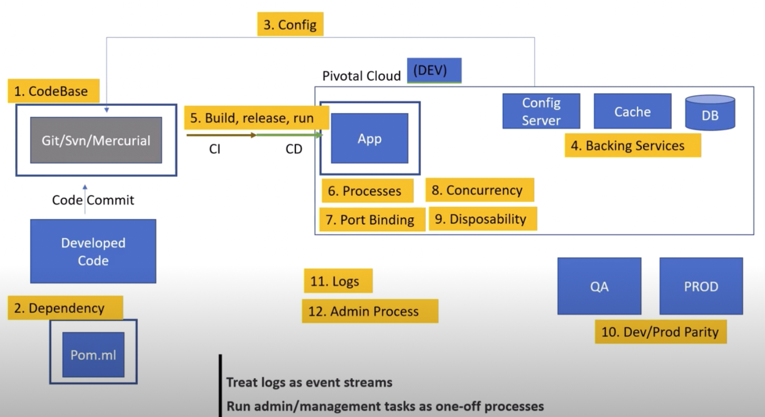
The global view

Slide 19
references
The twelve-factor app
12 Factor App - #6MinuteSaturdays #1 | Tech Primers
12 Factors App | MicroServices Architecture | Cloud Native Best Practices
Introduction to 12 Factor App
5 Years of 12 Factor Apps by Joe Kutner

